Slide 1
Predictive Modeling for Customer Booking
Finding most impactful features and evaluating predictive model

Slide 2
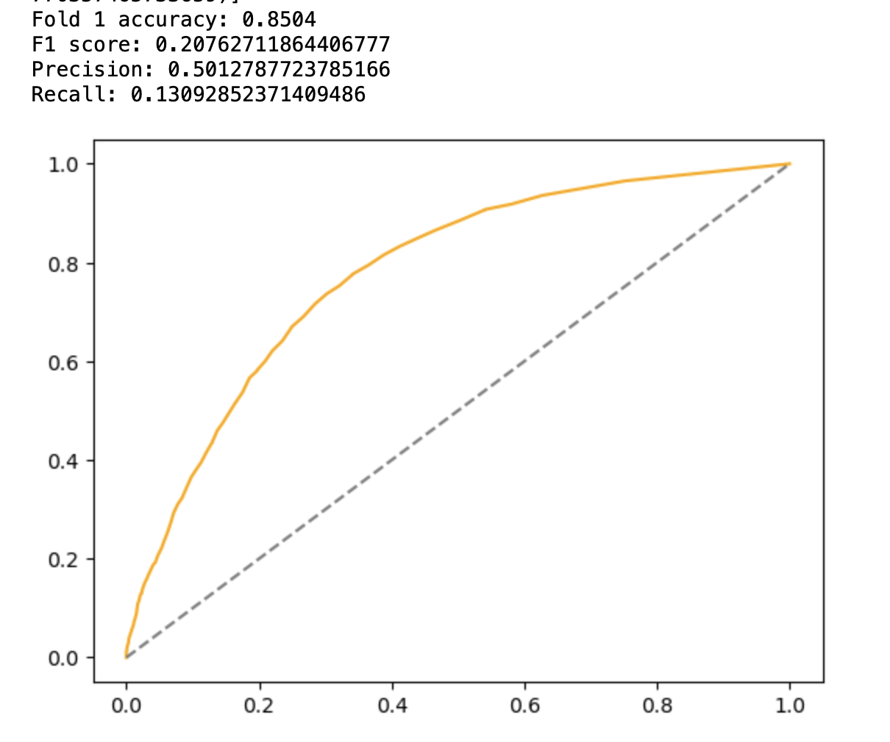
Top 5 important features considered:
Number of days between travel and book date
Hour of flight departure
Amount of time spent at destination
Number of passengers travelling

